Slide 1

Introduction to Ad Click Prediction
Ad click prediction is a crucial task in the world of digital advertising, where businesses aim to optimize their advertising campaigns and maximize their return on investment (ROI). This project explores the use of logistic regression, a powerful machine learning technique, to build a model that can accurately predict whether a user will click on an advertisement.

Slide 2

Objective of the Project
1
Understand Ad Click Behavior
2
Develop Predictive Model
Build a logistic regression model to predict the likelihood of a user clicking on an ad.
Analyze the factors that influence a user's decision to click on an advertisement.
3
Optimize Advertising Campaigns
Use the predictive model to inform and improve the targeting and placement of digital advertisements.

Slide 3
Overview of Logistic Regression
What is Logistic Regression?
Modeling Approach
Advantages
Logistic regression uses a logistic function to map the input features to a probability value between 0 and 1, representing the likelihood of the ad being clicked.
Logistic regression is a simple and interpretable model, making it easy to understand the relationship between the input features and the output prediction.
Logistic regression is a statistical model used to predict the probability of a binary outcome, such as whether a user will click on an ad or not.

Slide 4
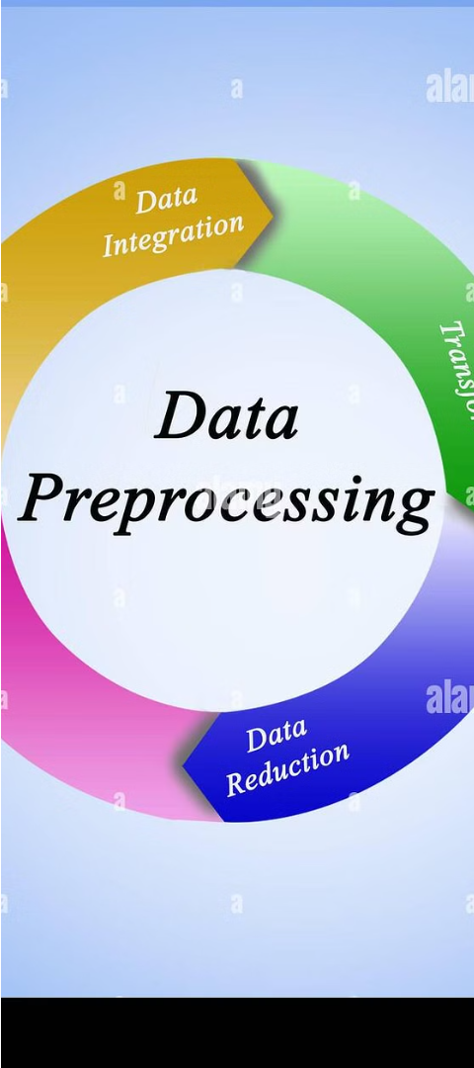
Data Summary and Preprocessing
1
Data Collection
The dataset includes information about user interactions with digital advertisements, such as user demographics, ad characteristics, and click behavior.
2
Data Cleaning
Handling missing values, removing outliers, and ensuring data quality to prepare the dataset for analysis.
3
Feature Engineering
Creating new features from the raw data to capture important relationships and improve the model's predictive power.

Slide 5
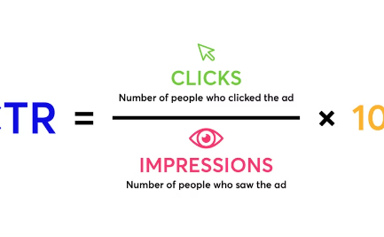
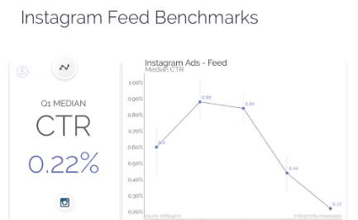
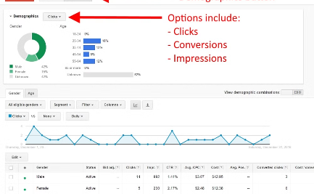
Exploratory Data Analysis and Visualization
Click Rate by Age
Click Rate by Gender
Click Rate by Country
Analyze the click rate distribution across different device types, such as desktop, mobile, and tablet, to understand user behavior.
Investigate the patterns in ad click rate throughout the day to identify optimal ad placement times.
Explore the relationship between user demographics (age, gender, location) and ad click behavior to inform targeted advertising strategies.

Slide 6
Class Distribution Analysis
Imbalanced Classes
Handling Imbalance
The dataset is likely to have an imbalanced class distribution, with a much higher number of non-click instances compared to click instances.
Techniques such as oversampling, undersampling, or class weighting may be necessary to address the class imbalance and improve the model's performance.
Evaluation Metrics
Model Optimization
Carefully select appropriate evaluation metrics, such as area under the receiver operating characteristic (ROC) curve, to assess the model's performance in the presence of imbalanced classes.
Tune the logistic regression model's hyperparameters to achieve the best balance between precision and recall for the target class (clicks).

Slide 7
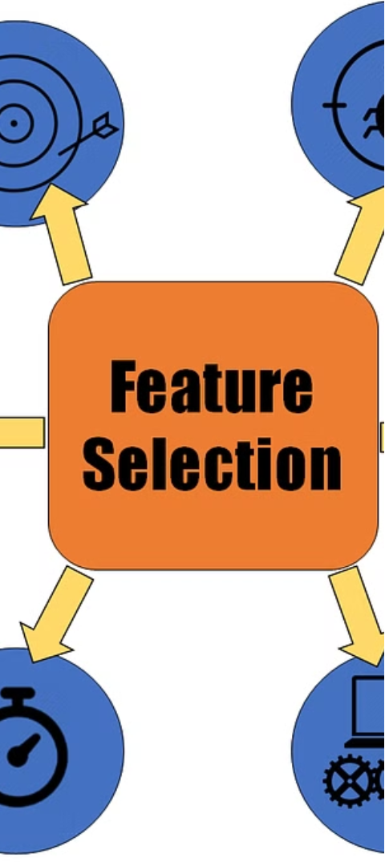



Feature Engineering and Selection
Identify Relevant Features
Analyze the available data and identify the features that are likely to have the most influence on ad click behavior, such as user demographics, ad characteristics, and contextual information.
Feature Engineering
Create new features by combining or transforming the existing data, aiming to capture hidden patterns and relationships that can improve the model's predictive power.
Feature Selection
Employ techniques like correlation analysis, recursive feature elimination, or sequential feature selection to identify the most important features and reduce the dimensionality of the input data.

Slide 8



Conclusion and Next Steps
Successful Model
Future Improvements
Deployment and Monitoring
The logistic regression model developed in this project has demonstrated the ability to accurately predict ad click behavior, providing valuable insights for optimizing digital advertising campaigns.
Explore the potential of more advanced machine learning techniques, such as neural networks or gradient boosting, to further enhance the model's predictive performance.
Integrate the model into the company's advertising platform and continuously monitor its performance, making adjustments as needed to ensure optimal results.

